Slide 1



Loan Application Calculator
DSC630 Winter 2022
Shaquiel Pashtunyar

Slide 2
Loan Applications
23-25 millions home loan applications in America per year
3-4% average default rate
30+ days to get an application approved
Average first mortgage was 298,725$ in 2022

Slide 3
Motivation
Make the home loan process more transparent
Quicken the process
Ensure more secured funds

Slide 4
Dataset
https://www.kaggle.com/datasets/gauravduttakiit/loan-defaulter
https://www.kaggle.com/datasets/kmldas/loan-default-prediction

Slide 5
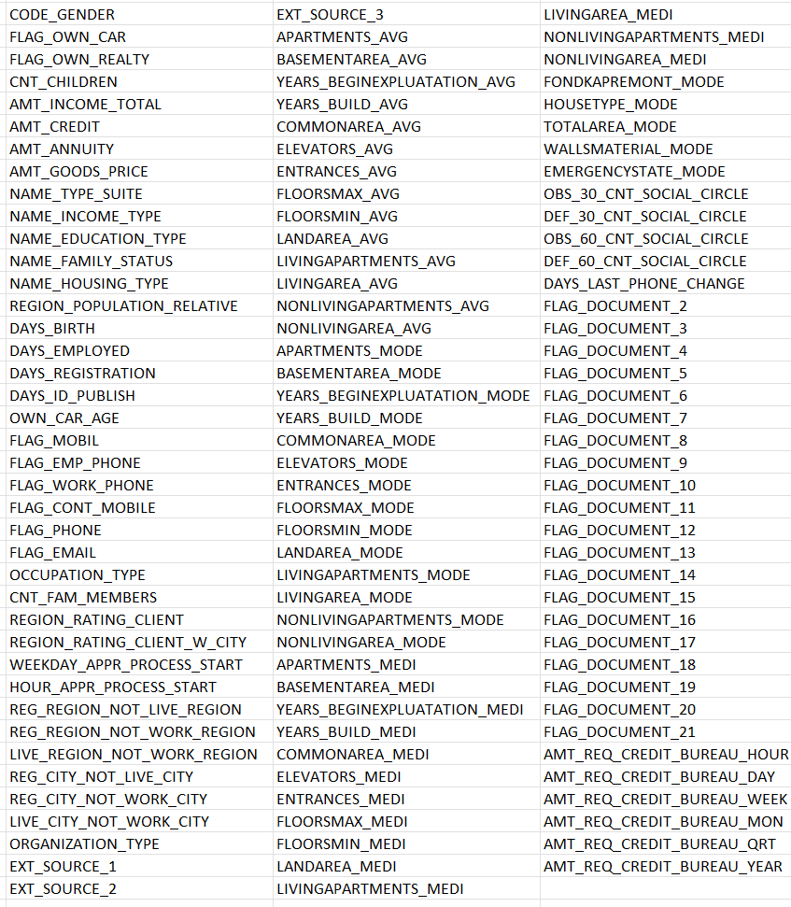
Features

Slide 6
Second data set features
Index
Employed
Bank Balance
Annual Salary
Defaulted

Slide 7
Data Insights
10000 loans
5 columns captured
No null values
3.3% defaulted

Slide 8
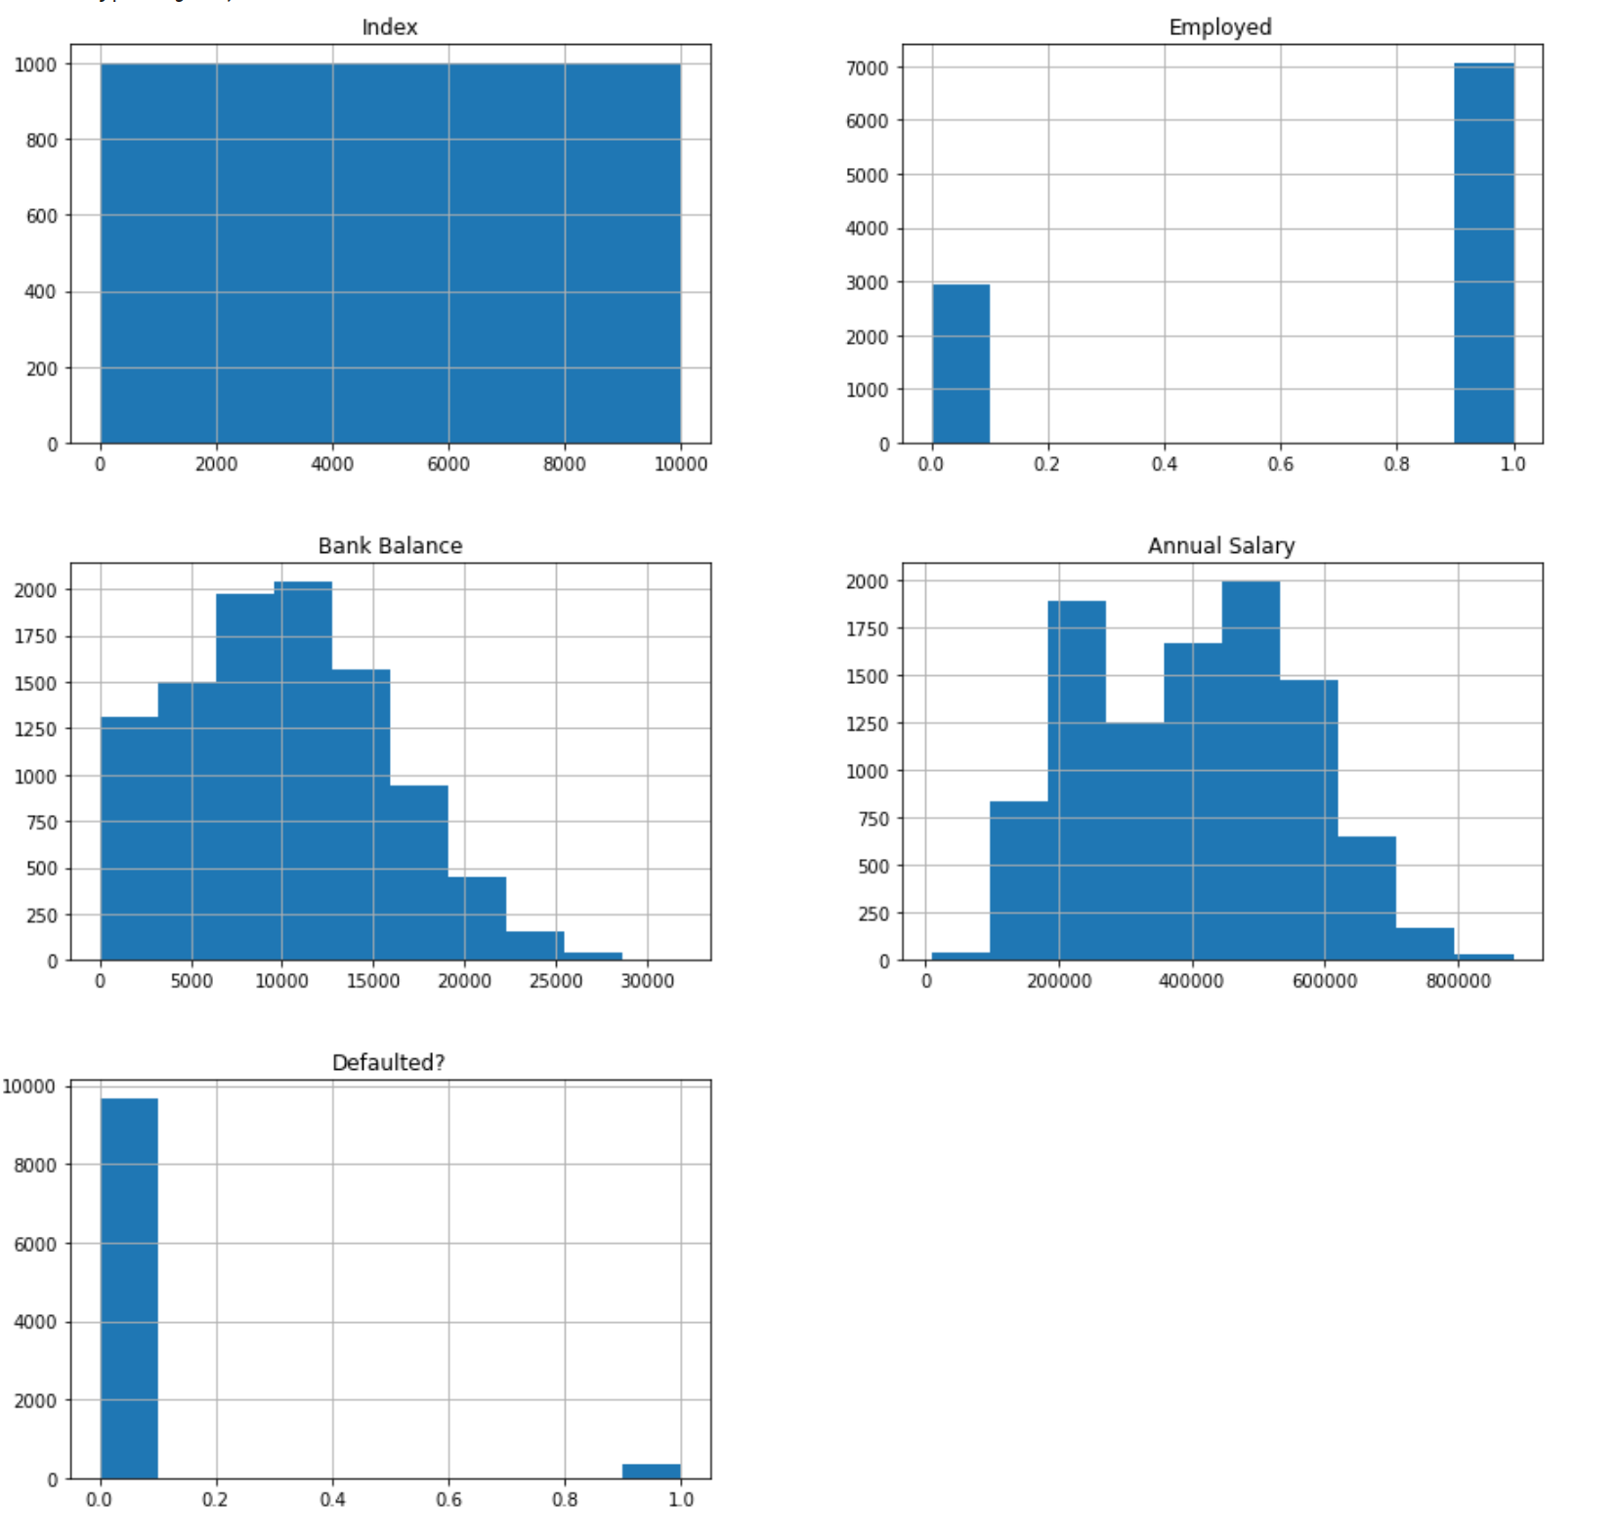
Category Distributions

Slide 9
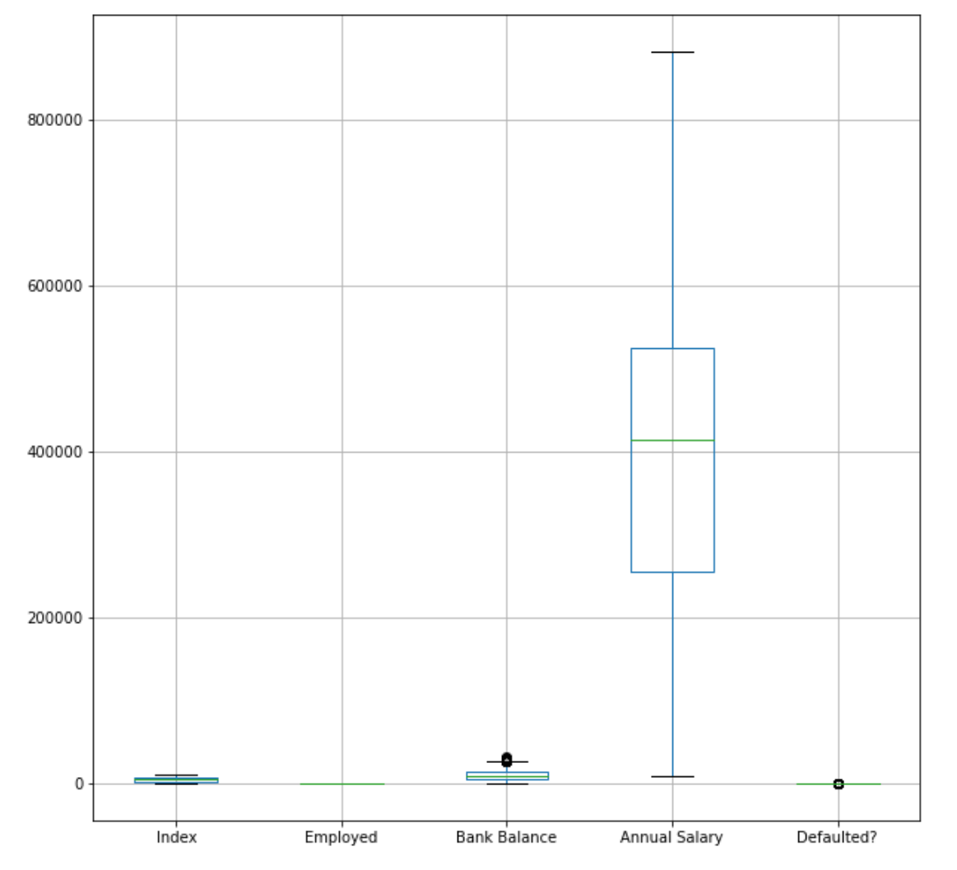
Category Box Plot

Slide 10
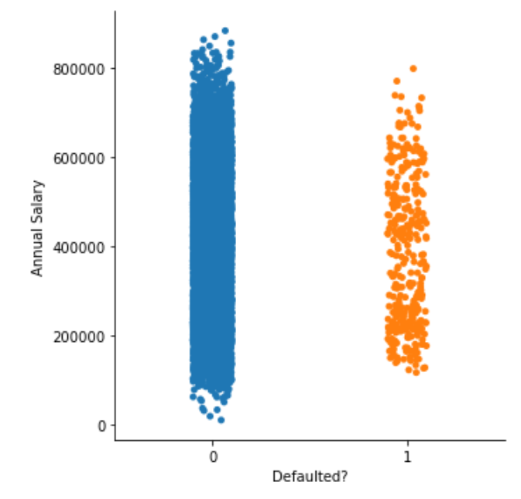
Salary vs Default Rate

Slide 11
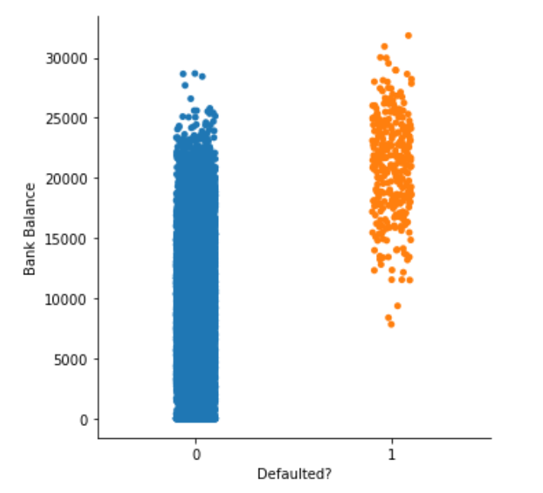
Bank Balance vs default rate

Slide 12
Test Plan
Prepare dummies
Split the data set
Run a logistic regression
Validate results

Slide 13
Methodology
Spread the employed field into Boolean dummy columns
Removed the index column
Split the data into test and training datasets 25/75
Performed Logistic regression on the training dataset
Confirmed results by checking it against the testing dataset

Slide 14
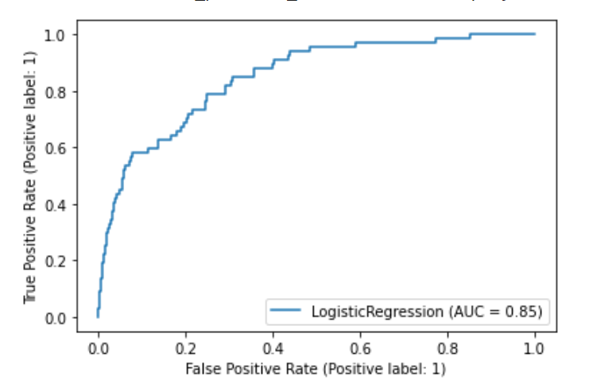
Results
Accuracy (R2) of 0.677
Roc curve on the right

Slide 15
Recommendations
Initial model had decent success
Increase the scope of variables
Target a higher accuracy rate
Attempt other models
Tree-Based Methods.
Neural Networks and Support Vector Machines.

